Slide 1
Lesson 5: Communicate Effectively
Learning Objectives:
Learn how incorrect assumptions and limiting our opinions about people can negatively impact our communication.
Identify the barriers which cause communication breakdowns, such as miscommunication and poor listening, and learn how to overcome them.
Understand the importance of listening and learn to listen actively.

Slide 2
Learn how incorrect assumptions and limiting our opinions about people can negatively impact our communication.
“Everything is not what it is”
When we meet people for the first time, we first make assumptions about them, like how dirty they are, how do they look, and many other assumptions
When we talk of effective communication we don’t mean perfect grammar or impressive words.
We simply mean:
Personality, body language, posture (how do get across to people and how we listen to them)

Slide 3
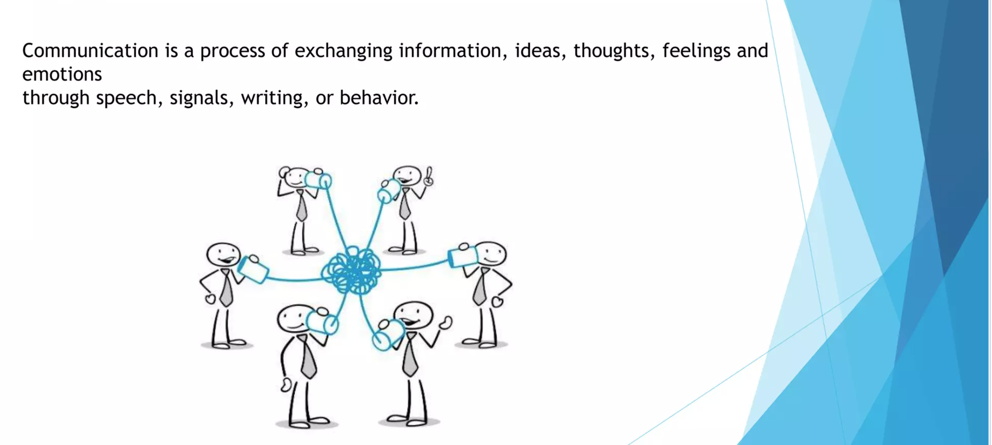

Slide 4
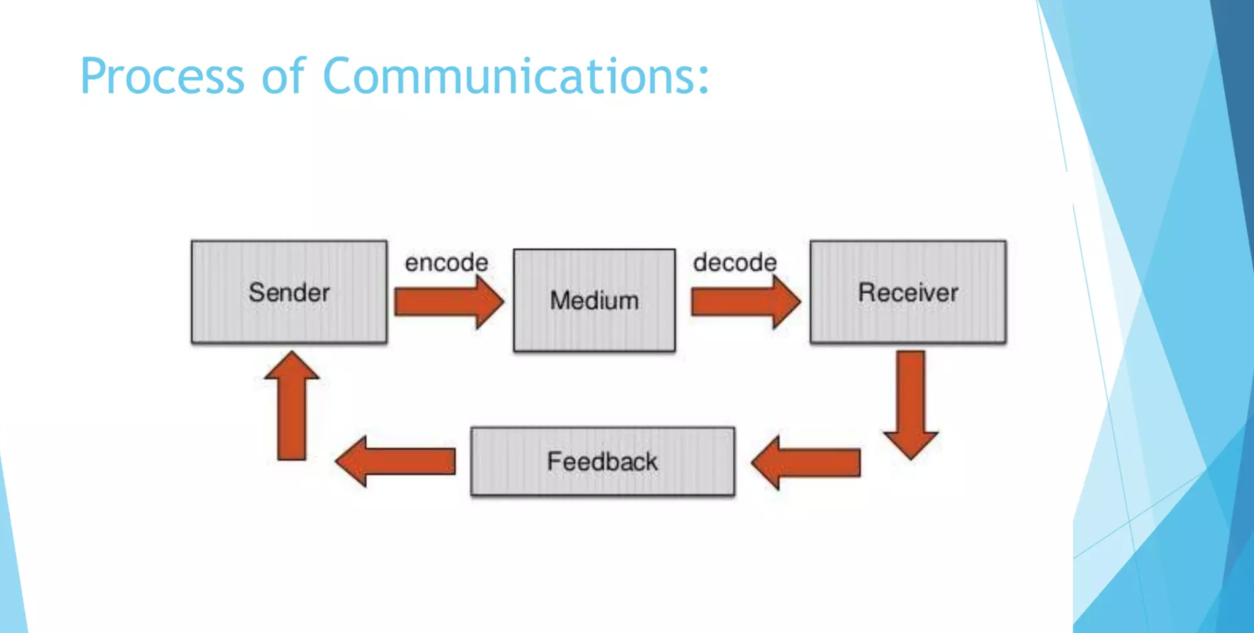

Slide 5
Types of business communication
There are two types of business communication
1. internal communication
2. external communication

Slide 6
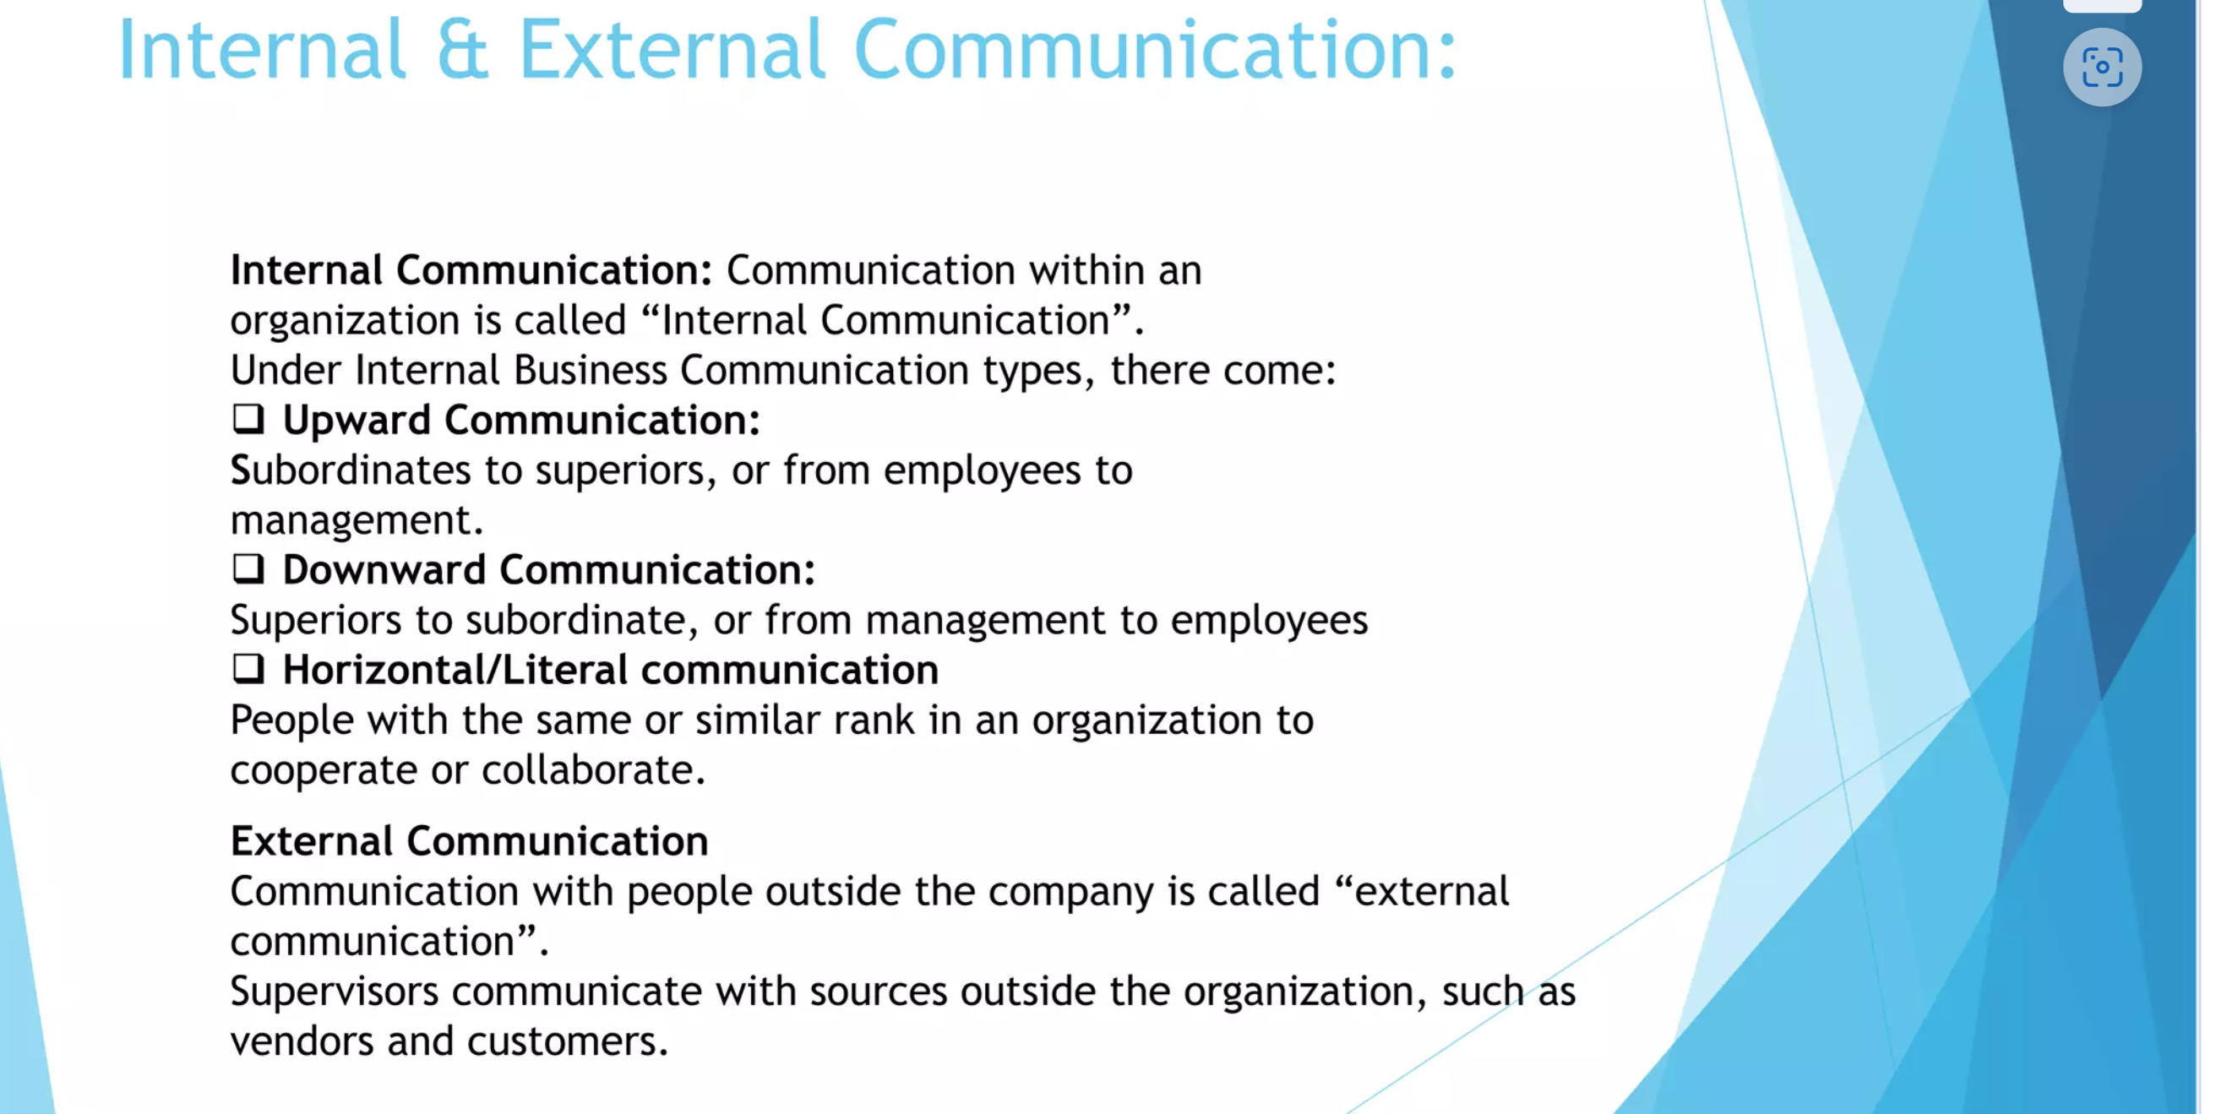

Slide 7
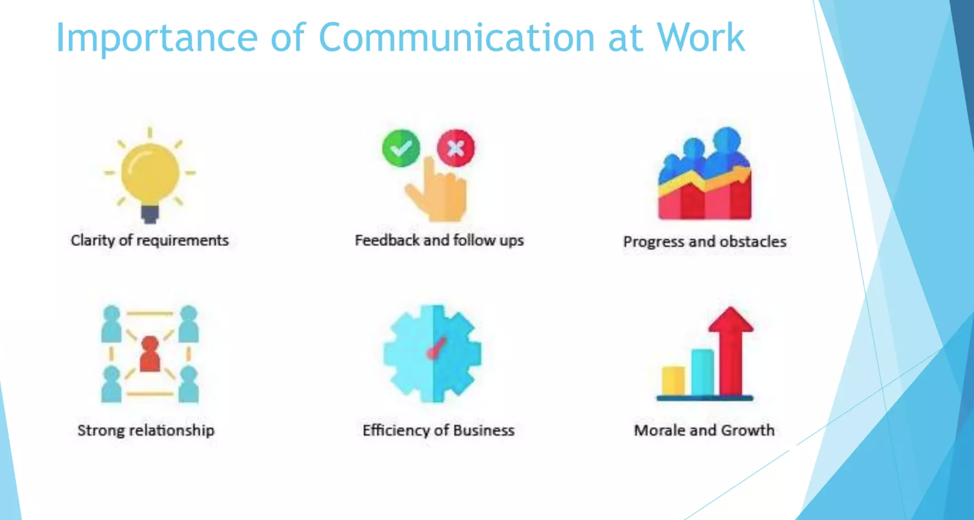

Slide 8
Importance of Communication at work
Clarity of Requirements
Entrepreneurs must clearly communicate their business vision, mission, and objectives to employees, investors, and stakeholders.
Ensures that team members understand their roles and responsibilities, reducing confusion and increasing efficiency.
Helps in securing funding by clearly explaining business models, market opportunities, and growth potential to investors.
Feedback and Follow-Ups
Regular communication with employees, customers, and mentors helps entrepreneurs refine their strategies.
Follow-ups with clients and investors build trust and long-term relationships.
Enables entrepreneurs to pivot quickly when business conditions change by incorporating feedback.

Slide 9
Progress and Obstacles
Team members can openly share challenges they face, allowing for faster problem-solving and decision-making.
Helps in managing risks and uncertainties in a dynamic business environment.
Strong Relationships
Entrepreneurs must network and build strong relationships with investors, customers, suppliers, and other stakeholders.
Good communication skills help in negotiating deals and securing business partnerships.

Slide 10
Efficiency of Business
Clear and transparent communication ensures that operations run smoothly, reducing delays and errors.
Helps in delegating tasks effectively, ensuring all team members work efficiently toward business goals.
Improves customer service by ensuring quick responses to inquiries and issues, leading to higher customer satisfaction.

Slide 11
Morale and Growth
Entrepreneurs who communicate well inspire and motivate their teams, leading to higher productivity.
Encourages an innovative and collaborative work environment, where employees feel valued and contribute ideas.
Helps in business expansion by effectively communicating growth plans to investors, partners, and employees.

Slide 12
Barriers to communication
Miscommunication- (inability to communicate adequately and properly)
e.g. A manager emails a task assignment to their team without providing clear instructions. As a result, some team members misinterpret the instructions and work on the wrong tasks, leading to confusion and delays.
Poor listening- (when a listener doesn’t get the message from the speaker)
Technical difficulties (e.g over the phone especially if you lose the connection)
Data misinterpretation- (when the data is interpreted in the wrong way)
e.g Customer Satisfaction Surveys: A restaurant conducts customer satisfaction surveys and finds that a particular dish receives low ratings. The management decides to remove the dish from the menu, assuming it's disliked. Later, they discover that the low ratings were primarily due to customers' dissatisfaction with the portion size, not the taste of the dish itself.
Incomplete sentence- (when the speaker do not complete the sentence while presenting data). E.g The sales numbers for Q1 were significantly higher than expected, with a growth ……of 15% compared to last year.
No paraphrasing-( When the words are not restated)
Language-(When the listener is not familiar with the language)

Slide 13
How to overcome these barriers
Eye contact- maintain eye contact when you speak to people
Nod your head and say things like: hmmm, go, ahaa etc
Let others to complete- let people complete their sentence
Don’t jump to conclusion- do not conclude right at the beginning
Clarify- always clarify your understanding
Be patient and listen well (combine both)

Slide 14
Communication style of an entrepreneur
The communication style of an entrepreneur can vary depending on their personality, industry, and business goals.
common characteristics and approaches for successful entrepreneurs
Visionary and Inspirational:
Entrepreneurs often have a strong vision for their business and are able to communicate it in an inspiring and convincing way.
They use storytelling techniques to paint a brilliant picture of their goals and aspirations, motivating others to rally behind their vision.
2. Confident and Assertive: Entrepreneurs are typically confident and assertive communicators. They are not afraid to share their ideas, voice their opinions, or take calculated risks. Their confidence brings trust and stimulates confidence in others, whether it's investors, employees, or customers.

Slide 15
3. Adaptable and Flexible:
Entrepreneurs need to be adaptable communicators who can express their message to different audiences and situations. Whether it's pitching to investors, negotiating with suppliers, or interacting with customers, they adjust their communication style to effectively engage with diverse stakeholders.
4. Transparent and Honest:
Successful entrepreneurs are honest and transparent in their communication, even when delivering difficult news or addressing challenges. They value open and honest communication within their team and with external partners.

Slide 16
6. Strategic and Results-Oriented:
Entrepreneurs communicate with a strategic focus, always keeping their business goals and objectives in mind.
They are results-oriented communicators who focus on driving action and achieving tangible outcomes. Their communication is purposeful and directed towards advancing their business objectives.
7. Continuous Learner and Listener:
Effective entrepreneurs are lifelong learners who continuously seek to improve their communication skills.
They are active listeners who value feedback and are open to learning from others. They adapt their communication style based on feedback and new insights, constantly refining their approach to better connect with their audience.

